Slide 1
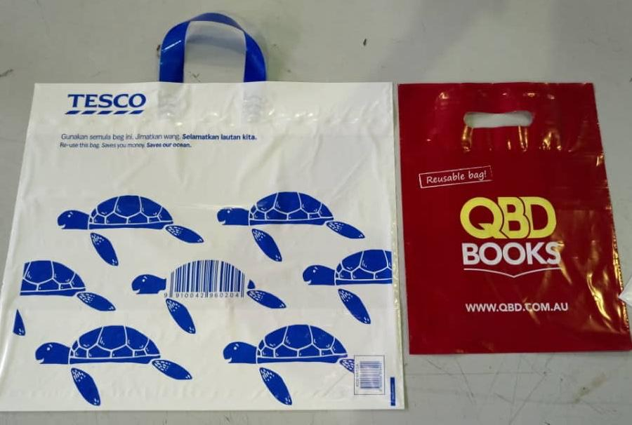
LOOP HANDLE
BAG
PATCH HANDLE
BAG
LOOP HANDLE
BAG
PATCH HANDLE
BAG

Slide 2
HANDLE
LOOP
PATCH

